Slide 1
Introduction to Operating Systems DK
Notes:
Keep language simple. Use examples: FASTQ files, conda, servers.

Slide 2
What is an OS?
The OS is the manager of your computer.
Communication between apps and hardware (CPU, memory, disk, internet).
Keeps things organized and safe: files, users, permissions.
Windows/macOS: laptops and lab desktops (documents, browsing)
Linux: most servers, clusters, cloud machines
Notes:
Software layer between applications and hardware

Slide 3
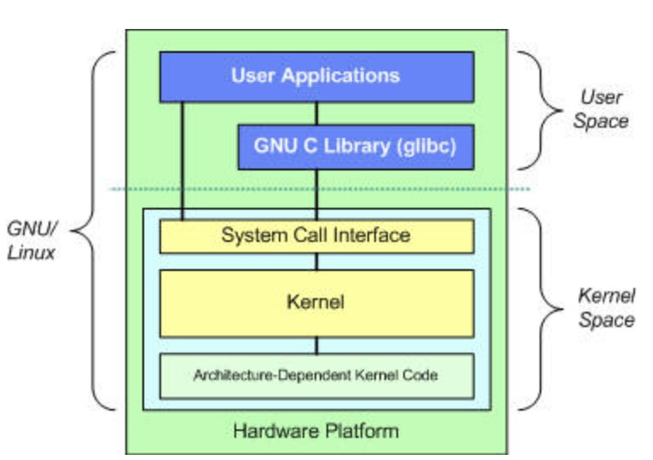
Linux
Open-source, Unix-like operating system founded by Linus Torvalds in 1991
Composed of the Linux kernel + tools & utilities
Linux kernel serves as the foundation and interface between the computers hardware and software
Available in multiple distributions (distros): Ubuntu, CentOS, Debian, Fedora, Red Hat Linux etc.
Supports GUI and command-line interface (CLI), but CLI is where the power lies
Notes:
The Linux kernel is the core of the Linux operating system—the part that runs with the highest privilege and talks directly to your hardware.

Slide 4
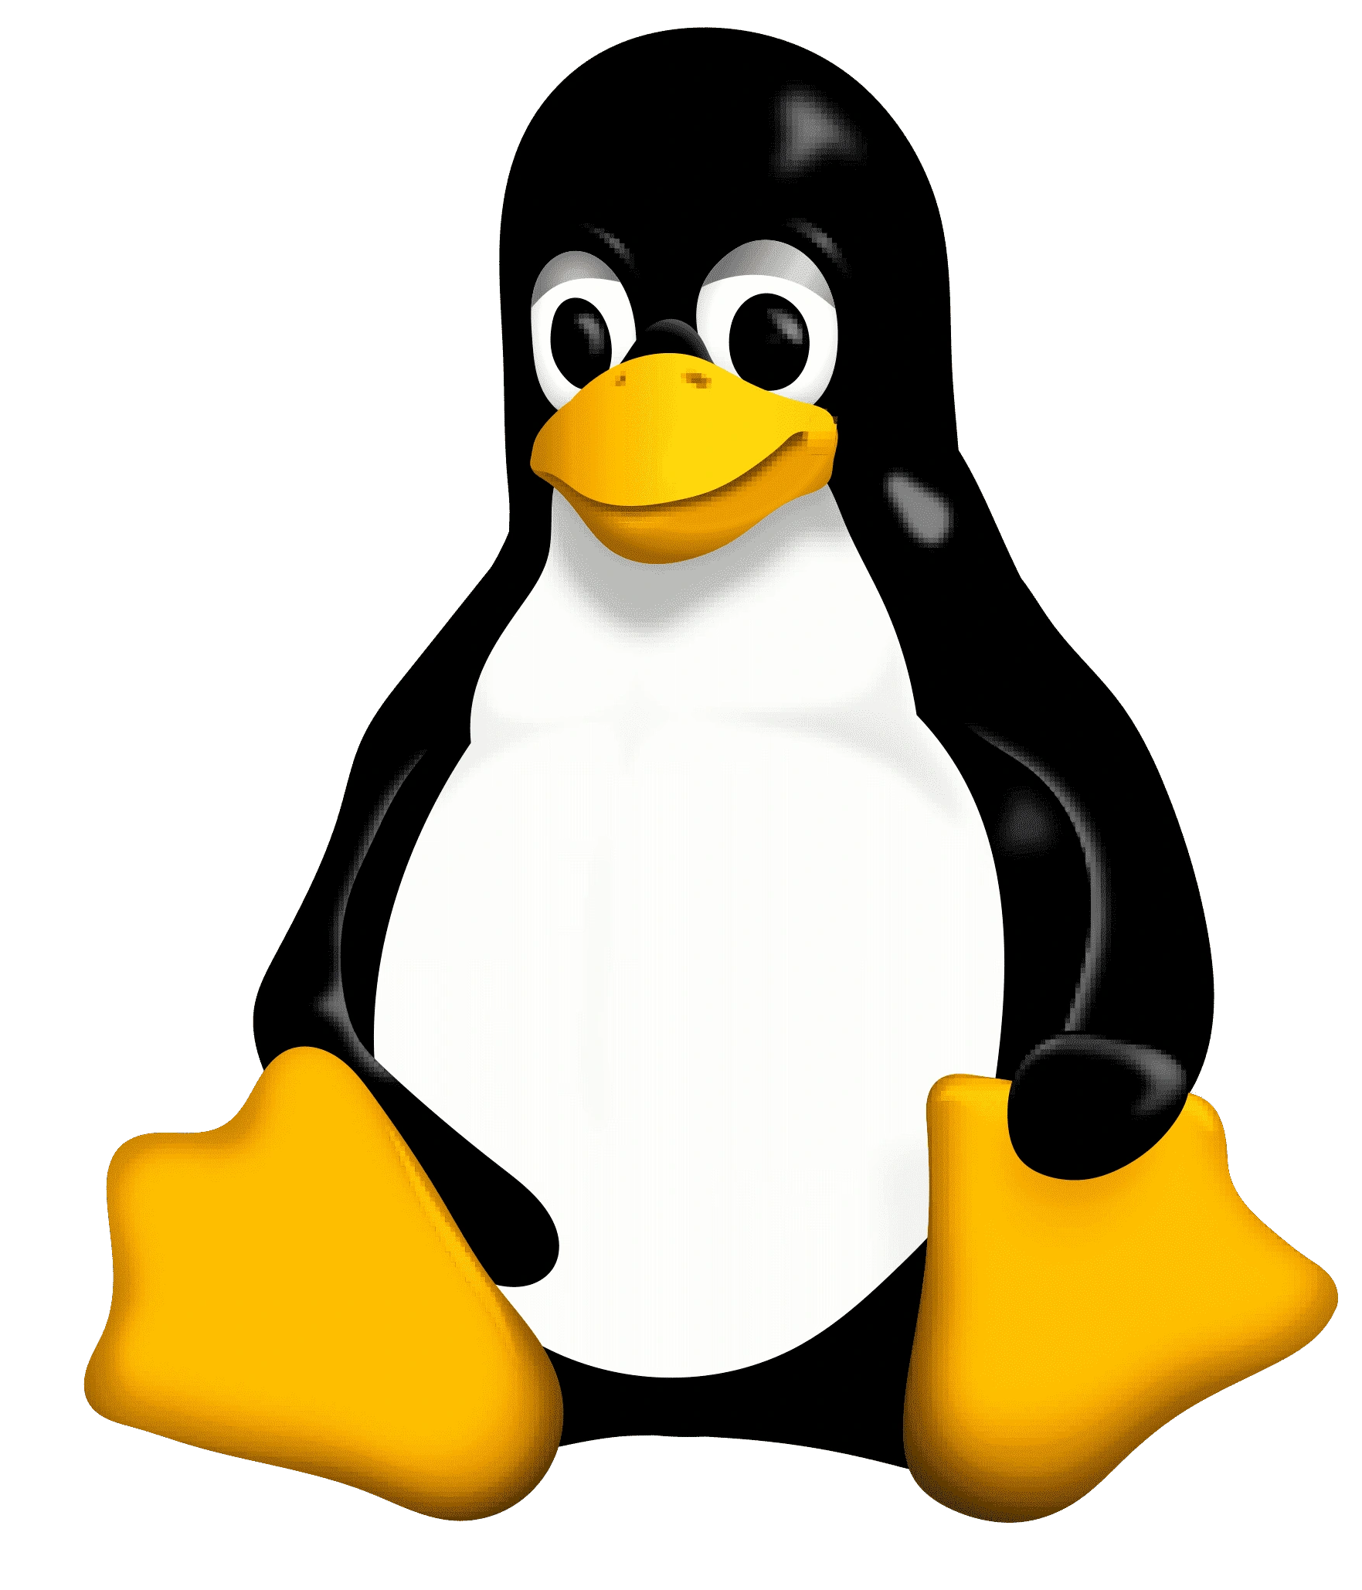
Key features
Open Source & free – community driven development
Stability & Reliability – runs for months/years without crashing
Security – User permissions and robust security model
Flexibility – works on desktops, servers, HPC clusters and cloud

Slide 5


Linux in the Scientific World
Backbone of supercomputers and HPC clusters
Enables automation and scripting for repetitive tasks
Handles large-scale data processing efficiently

Slide 6


Why Bioinformaticians Love Linux
Most bioinformatics tools are Linux-native (e.g., BWA, SAMtools, GATK)
Easy pipeline automation using Bash, Snakemake, Nextflow
Open-source ecosystem: R, Python, Conda, Docker all integrate seamlessly
Package managers simplify software installation (e.g., apt, conda)

Slide 7
Linux use in bioinformatics?
Big files (FASTQ/BAM) → need good file habits
Many tools (FastQC, BWA, Nextflow) → need an easy way to install/manage
Servers and clusters run Linux → you’ll use a terminal at some point
Reproducibility → record versions and keep things tidy
Absolute path: starts at the top (e.g., /home/dk/project)
Notes:
Connect to real tasks.

Slide 8
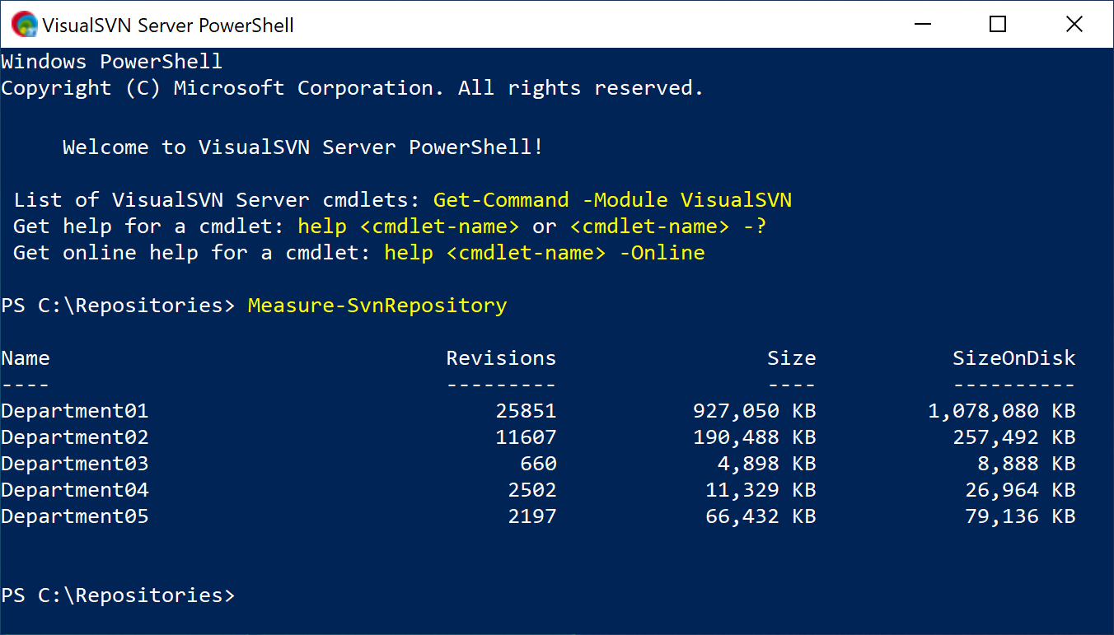
Windows (desktop) basics
File Explorer: create folders for projects (e.g., C:\Users\you\projects\my_project)
Task Manager: see CPU/memory usage (Ctrl+Shift+Esc)
Open a terminal: Start → type “cmd” (Command Prompt) or “PowerShell”
Notes:
Show where Downloads/Documents are; stress keeping projects in a clean folder tree.

Slide 9
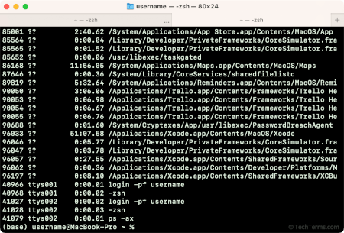
macOS (desktop) basics
Finder: create a project folder (e.g., /Users/you/projects/my_project)
Activity Monitor: see CPU/memory usage (Spotlight → Activity Monitor)
Open a terminal: Spotlight (⌘+Space) → type “Terminal” (zsh)
Notes:
Point out Home (~) path and how to make a tidy project tree.

Slide 10
Connecting to a server (SSH)
Windows 10/11: use built‑in OpenSSH → ssh user@server
macOS: Terminal → ssh user@server
Move files: scp local.txt user@server:~/ (or FileZilla GUI)
Notes:
If ssh missing on older Windows, add Optional Feature: OpenSSH Client.

Slide 11
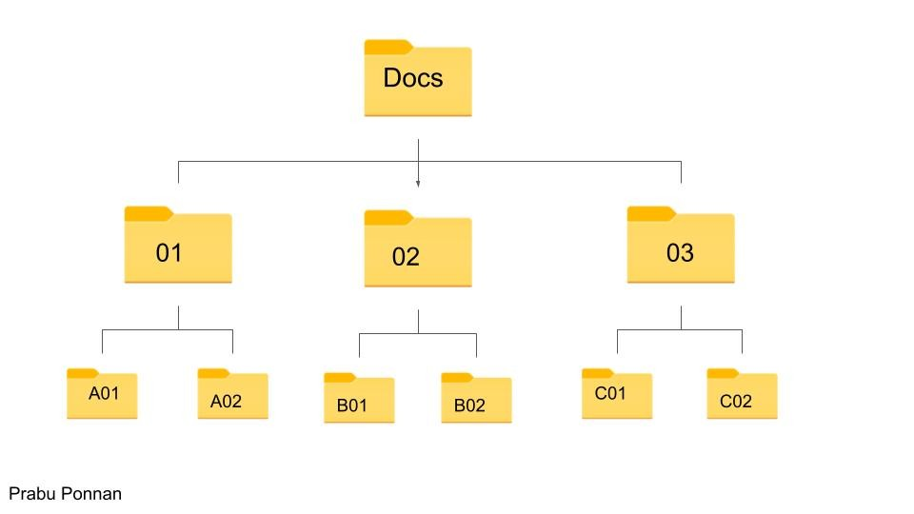
Files & folders 101
Everything lives in folders (directories). Keep projects separated.
Use short, clear names; avoid spaces (or use underscores).
Back up important work (external drive, cloud, server home).
Notes:
Demo creating a clean project tree.

Slide 12
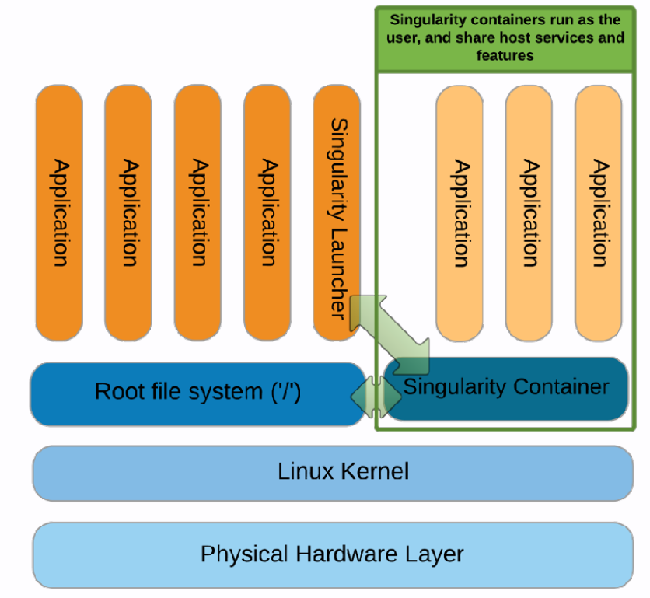


Containers in Bioinformatics
Lightweight, portable units of software.
Package an application + dependencies (libraries, tools, configs) into one environment.
Run consistently across laptops, servers, and the cloud.
Docker – most popular container platform.
Singularity – widely used on HPC systems (clusters).

